Slide 1
SIT094 – The Collection & Analysis of Quantitative Data
Week 8
Luke Sloan
Questionnaire Design

Slide 2

Introduction
Measuring Social Concepts
Validity
Reliability
From Hypotheses to Questions
Quantitative Data & Surveys
Designing Questionnaires
Workshop

Slide 3
Measuring Social Concepts
First you need to define them e.g. is marriage breakdown…
A legal decision (divorce)?
Living apart?
Having an affair?
How will you operationalise this? What questions will you use to ‘tap into’ the concept? What will the responses be?
For example, social class is extremely difficult to operationalise – if measured properly it requires a 30 min interview
Because data in the social world is fuzzy you may develop ‘proxies’ for difficult concepts e.g. social class as occupation, poverty using postcode (IMD), racism as a response to statements
Note that social class, poverty and racism are all social constructs and are not directly measurable - this can lead to measurement error…

Slide 4
Validity
CRITERION VALIDITY
“… involves comparing the way people rate on [a] new measure with how they rate on well-established measures of the concept.” (de Vaus 2011)
For example using existing racism metric as a benchmark and comparing with your new metric
Assumes that benchmark is initially correct – and many social concepts are not yet established
CONTENT VALIDITY
“… evaluates how well the measures tap the different aspects of the concept as we have defined it.” (de Vaus 2011)
For example using an IQ test to establish intelligence (a very particular type!)
In social science there is rarely consensus on nature of ‘content’ – what makes a racist?
CONSTRUCT VALIDITY
“… relies on seeing how well the results we obtain when using the measure fit with theoretical expectations.” (de Vaus 2011)
For example predicting that as age increases so does ‘racism’ – what if your results do not support your hypothesis? If your theory or your measurement wrong?
No way to prove which one is incorrect and only assessable during the analysis (too late to redo)

Slide 5
Reliability
“A reliable measure is one that gives the same ‘reading’ when used on repeated occasions.” (de Vaus 2011)
For example, a speedometer that measured a car travelling at 55mph and then at 72mph would be useless if the car had not actually changed speed
Sources of unreliability can be:
Poor question wording
Different formats of data collection instruments
Ordering of questions
Lack of knowledge/opinion
Difficult questions (how much do you earn a week?)
What if I asked you how healthy your were in January and then again in July?

Slide 6
From Hypotheses to Questions
We use data collection questions to collect the data with which we can test our hypotheses
They form part of the data collection instrument (interview schedule, survey etc…)
For example, to test the hypothesis that males do worse than females at GCSE English…
Are you male or female?
What was your final result for GCSE English?
If you’re distinguishing between exams and coursework you might also ask…
What was your final coursework mark for GCSE English?
What was your final exam mark for GCSE English?
You must make sure that your data collection questions answer your hypotheses!

Slide 7
Quantitative Data & Surveys
Surveys are the mainstay of quantitative data collection, but any data collection instrument can collect numeric data
However surveys are potentially cheap, quick, convenient (for researcher and respondent) and reduces interviewer bias
They also allow us to gather the opinions of many people relatively easily – our samples need to be representative of the population
However you cannot prompt or probe and irrelevant questions cause fatigue
Issues of literacy, language, response rates
Importantly, all questions can be read in advance (e.g. fast driving)

Slide 8
Designing Questionnaires I
MEDIUM
Face-to-face
Telephone
Email
Web 2.0
TYPE
Paper
Electronic
Audio responses?
STYLE
Set responses
Open text
Anonymous?
Logic routing?
Remember to use different types of questions to gather data…
Closed questions
Open-ended questions
Multiple choice
Likert scales
Scenarios
Heat maps
Personal factual questions
Factual questions about others (informant)
Questions about attitudes
Questions about beliefs
Questions about normative standards & values
Questions about knowledge (testing)

Slide 9
Designing Questionnaires II
Due to the removal of the researcher at the data collection phase there are certain issues that you must keep in mind…
Avoid general (unspecific) questions
‘How satisfied are you with your job?’
Avoid double-barrelled questions
‘How satisfied are you with your job and pay?’
Avoid negatives (and double negatives!)
‘Do you not agree with not reviewing your pay?’
Don’t make people answer irrelevent questions
‘How much do you earn?’ to someone who is unemployed (routing!)

Slide 10
Designing Questionnaires III
Cover page explaining study and data usage – official not personal
Formatting and appearance is important
Page should not look ‘busy’
Survey should not be too long
Use matrixes to compress questions
Scrolling for online surveys or more pages?
Why would anyone want to fill it in?
Clarify response expectations (tick one/all that apply)
How will logic routing work remotely?
You should have a look at some of the national surveys online to get an idea

Slide 11
Designing Questionnaires IV
The key to a successful questionnaire is good coding!
Give a case number for each questionnaire (ID)
Give a number for each response option (except open text fields)
Use actual numbers (responses) for numeric data
Try to standardise/categorise answers for open ended questions (create codes for each category)
May help to type codes next to response on questionnaire
Think about missing data e.g. -99 = ‘missing’, -88 = ‘not applicable’?

Slide 12
Example Questionnaire

Slide 13
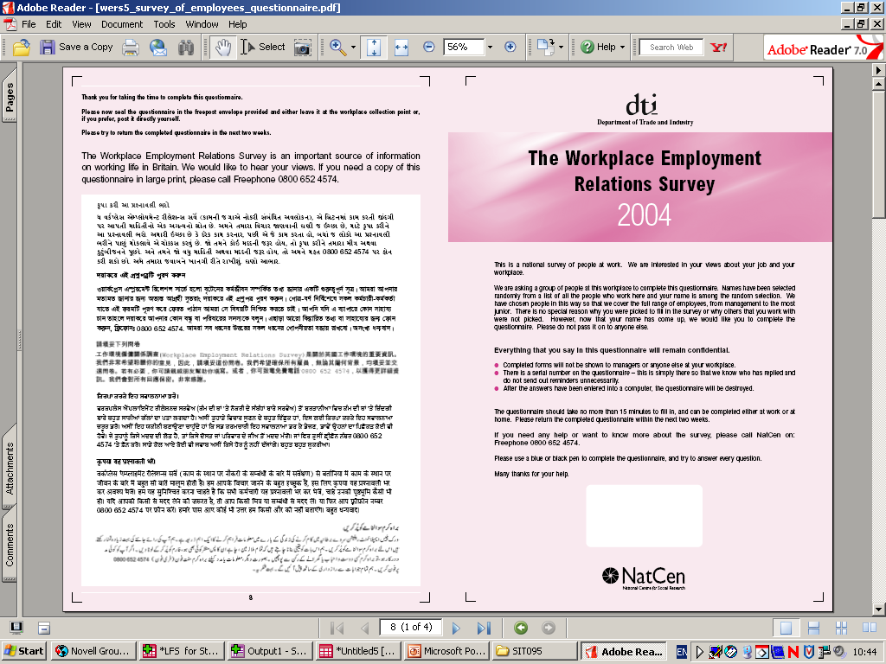

Slide 14
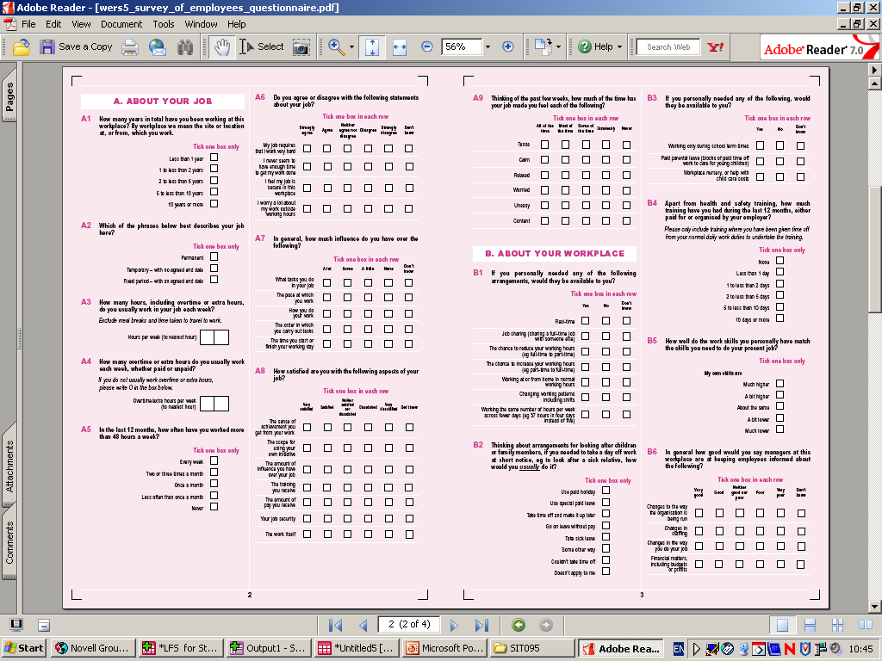

Slide 15
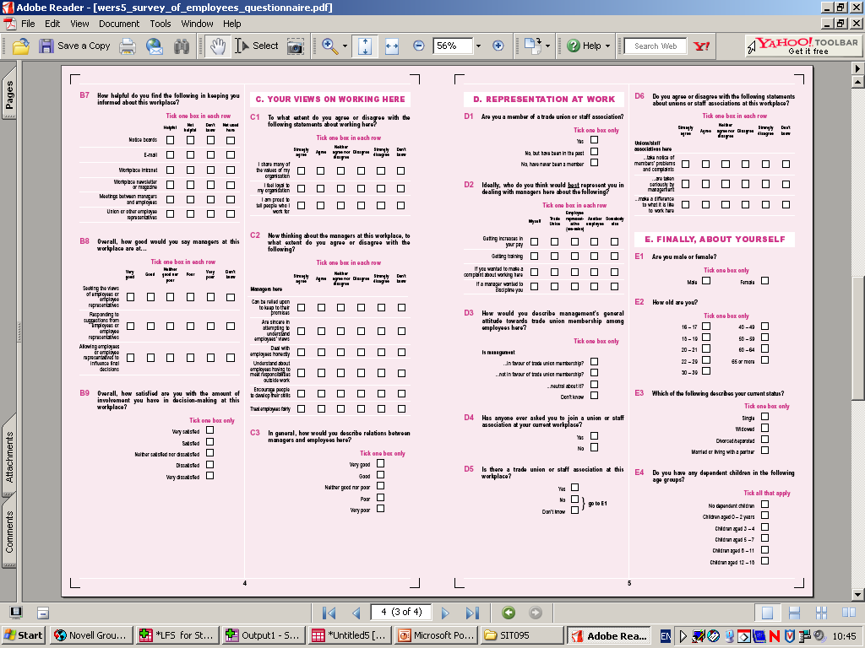

Slide 16
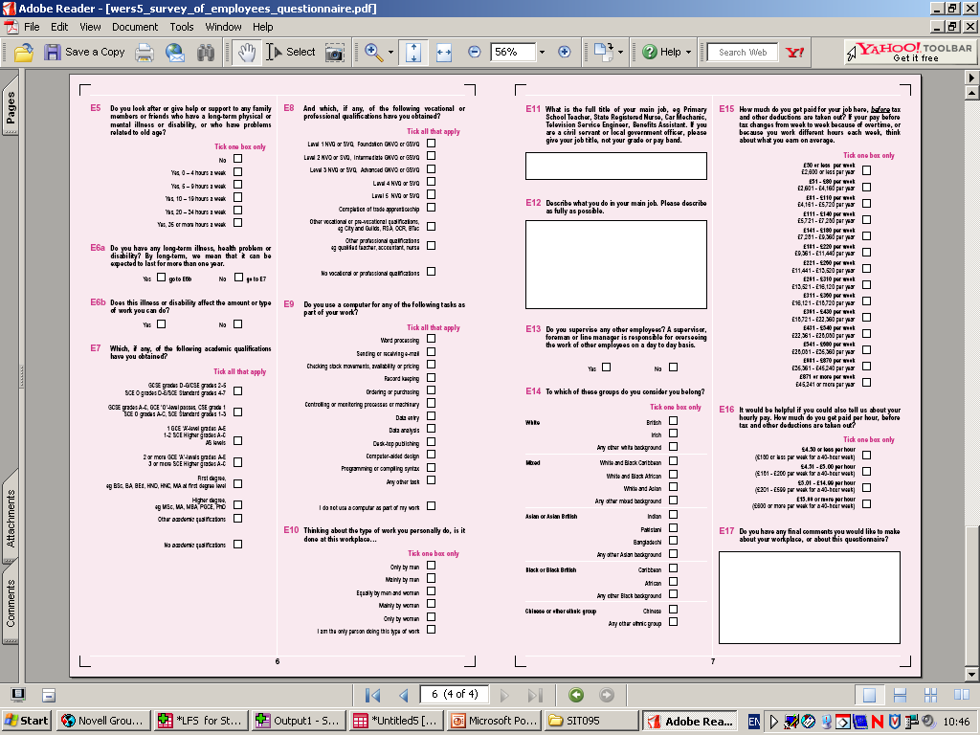

Slide 17
Always pilot your interview questions and your questionnaires

Slide 18
How reliable and valid do you think the following questions are?

Slide 19
Question 1
How well can you speak English?
☐ Very well
☐ Well
☐ Not well
☐ Not at all
Does this measure the correct concept?

Slide 20
Question 2
Which of these qualifications do you have?
☐ 1-4 O levels/CSEs/GCSEs (any grades), Entry Level, Foundation Diploma
☐ NVQ Level 1, Foundation GNVQ, Basic Skills
☐ 5+ O levels (passes)/CSEs (grade 1)/GCSEs (grades A*-C), School Certificate, 1 A level/2-3 AS levels/VCEs, Higher Diploma
☐ NVQ Level 2, Intermediate GNVQ, City and Guilds Craft, BTEC First/General Diploma, RSA Diploma
☐ Apprenticeship
☐ 2+ A levels/VCEs, 4+ AS levels, Higher School Certificate, Progression/Advanced Diploma
☐ NVQ Level 3, Advanced GNVQ, City and Guilds Advanced Craft, ONC, OND, BTEC National, RSA Advanced Diploma
☐ Degree (for example BA, BSc), Higher Degree (for example MA, PhD, PGCE)
☐ NVQ Level 4-5, HNC, HND, RSA Higher Diploma, BTEC Higher Level
☐ Professional qualifications (for example teaching, nursing, accountancy)
☐ Other vocational/work-related qualifications
☐ Foreign qualifications
☐ No qualifications

Slide 21
Question 2 – A Commentary
Firstly – does anyone know how to answer?
Very strange ordering and distinctions
Overlapping categories (e.g. ‘PGCE’ and ‘professional qualification – teaching’ in different groups?
Scottish Highers? Students who moved to England? Surely not a ‘foreign qualification!
What about the International Baccalaureate? Certainly not ‘foreign’…
Distinguishes between 1 and 2 A levels (or 2-3 and 4+ AS levels) but not a BSc/Ba and postgraduate qualification
Last point is odd considering the growing number of university graduates and the increased demand for postgraduate training

Slide 22
Question 3
Think about your weekly grocery shop. What proportion of your expenditure is spent on the following items in a typical week? (e.g. 15% spent on fruit)
☐ Fruit
☐ Vegetables
☐ Meat
☐ Confectionary
☐ Alcohol
☐ Entertainment
☐ Clothes
Such ‘ratio’ questions are common in market research
Very difficult to answer (issues for reliability)
Proportion of expenditure requires complex thought processes

Slide 23
Any Questions?

Slide 24
Workshop
Go to the Survey Question Bank online (surveynet.ac.uk/sqb/)
Select ‘Topics’ from the menu on the left
Browse a topic that your are interested in
Try to find questions that you think may be unreliable or lack validity!

